Slide 1
Code improvement: refactoring and static code analysis
45426: Teste e Qualidade de Software
Ilídio Oliveira
v2025-03-18

Slide 2
Learning objectives
Identify the occurrence of “bad smells” in code
Propose refactoring options for given “code smells”
Explain the role of Inspectors (static code analysis)
Describe the metrics used in SonarQube
Define the concept of technical debt and explain how it should be managed in a SQEnvironment

Slide 3
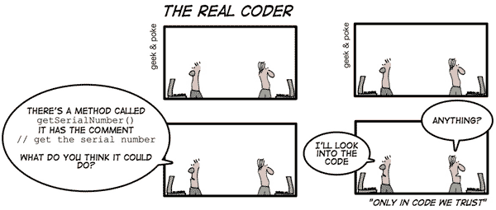

Slide 4

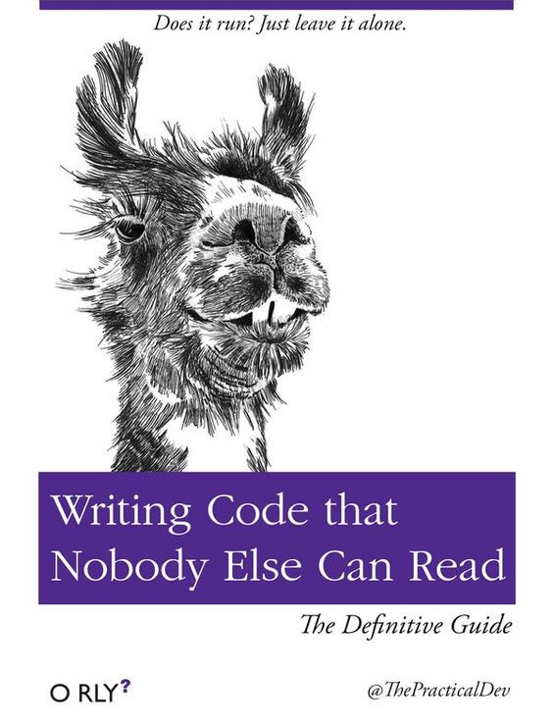

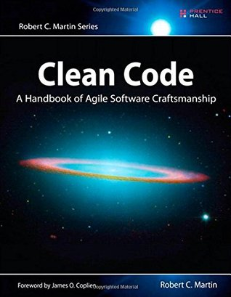
Not all code is equally easy to maintain
See also: “Playlist” @ OReilly
Find the intruder…

Slide 5
Clean code
Code as communication
  code is read much more often than it is written!
  anyone can write code that compiles, but…
  true mastery is to write code for other people (easy to understand and maintain)
Video talks by “uncle Bob”
  Talks on Clean Code (see link in Moodle)
https://learning.oreilly.com/library/view/clean-code-a/9780136083238/

Slide 6
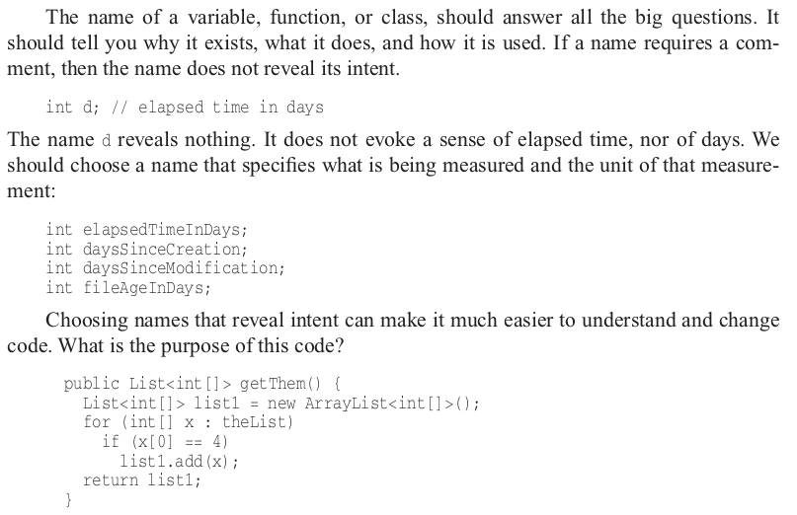
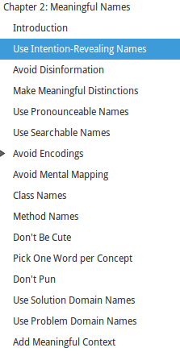
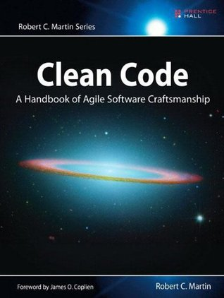



Slide 7
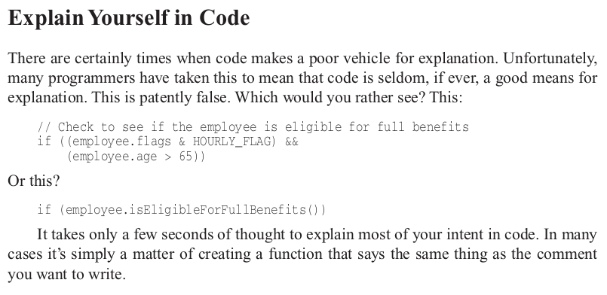
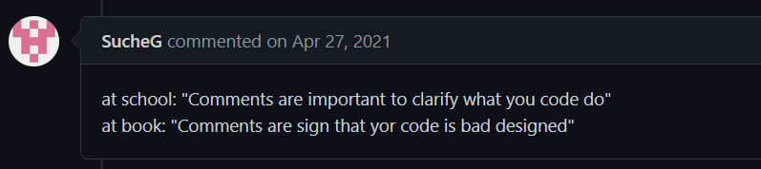

Clean code
In: https://gist.github.com/wojteklu/73c6914cc446146b8b533c0988cf8d29

Slide 8
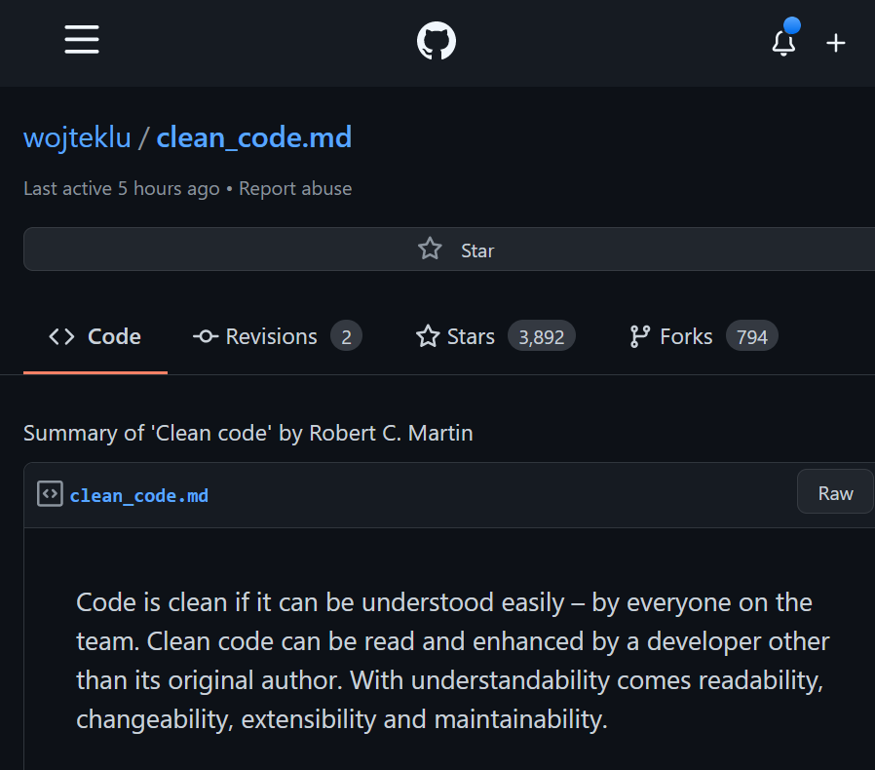
Many “articles” inspired in clean coding
Summaries on “Clean Code” available from Internet
https://gist.github.com/wojteklu/73c6914cc446146b8b533c0988cf8d29

Slide 9
Refactoring practices

Slide 10
Code refactoring
  Refactoring is a controlled technique for improving the design of an existing code base
  …altering its internal structure without changing its external behavior.
Key aspects:
    series of “small” transformations
    preserving functionality
    & correctness.
Examples
  Extract (duplicate code into a) method
  Extract interface (segregate responsibilities)
  See also:
    Source Making: refactoring techniques
    Fowler: Catalog of refactoring situations
Do I need this? Several IDEs will automate refactoring…

Slide 11
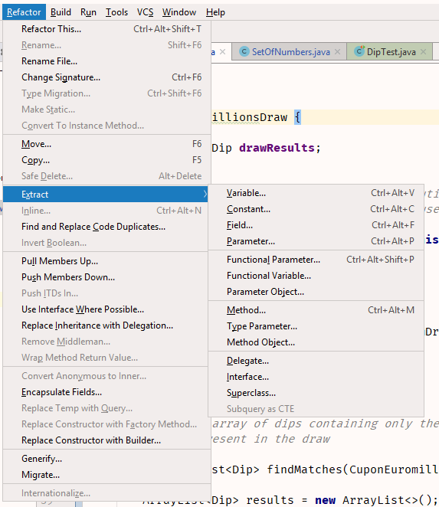
IntelliJ support

Slide 12
When to refactor?
Resolve “code smells” (anti-patterns)
  See: catalog of code smells
Examples:
  Duplicate code → Extract method
  Long method → Extract method
  Feature Envy → Move method
  Long parameters list → introduce object / preserve object

Slide 13
Why refactoring? MAINTAIN & EVOLVE!
Cleaner code
  is easier to understand and maintain
Better design
  adjust to the current understanding of the architecture
Reduce complexity
  easier to understand and evolve
Make the code more reusable
  component-like thinking (generalize for other needs)
Improve performance
Improve security
  by removing vulnerabilities

Slide 14
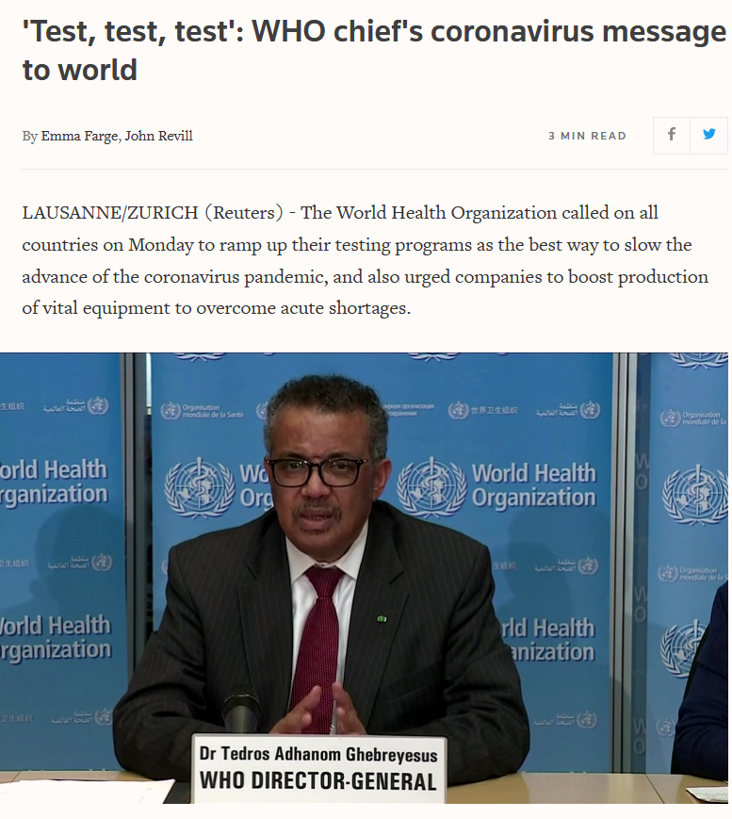
Picking a mantra…
‘Maintainable code, maintainable code, maintainable code’!

Slide 15
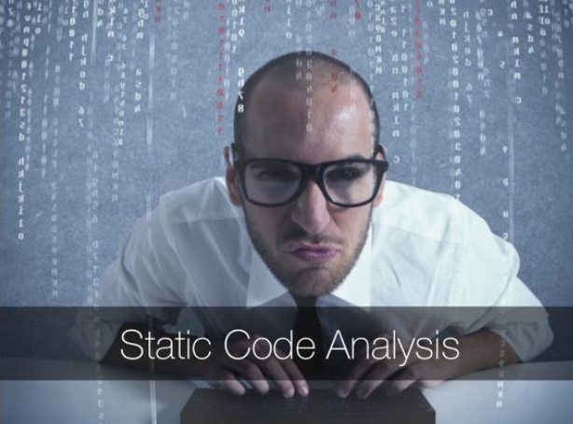

Slide 16
Code inspection
Analysis of code patterns, without running the code
Examples of issues found in SA:
  Referencing a variable with an undefined value
  Variables that are never used
  Unreachable (dead) code
  Programming standards violations
  Security vulnerabilities
    E.g.: possible SQL injections
  Internationalization (i18n) issues

Slide 17
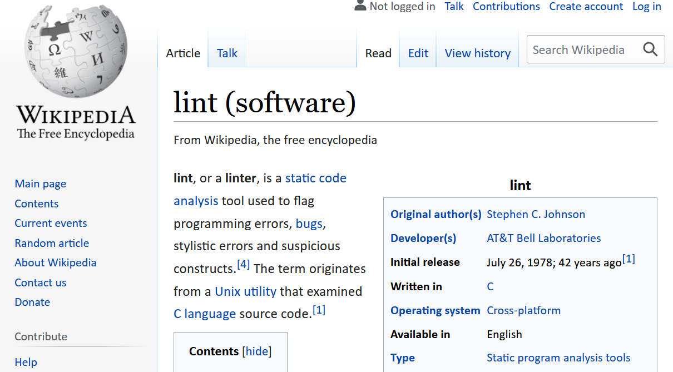


Slide 18
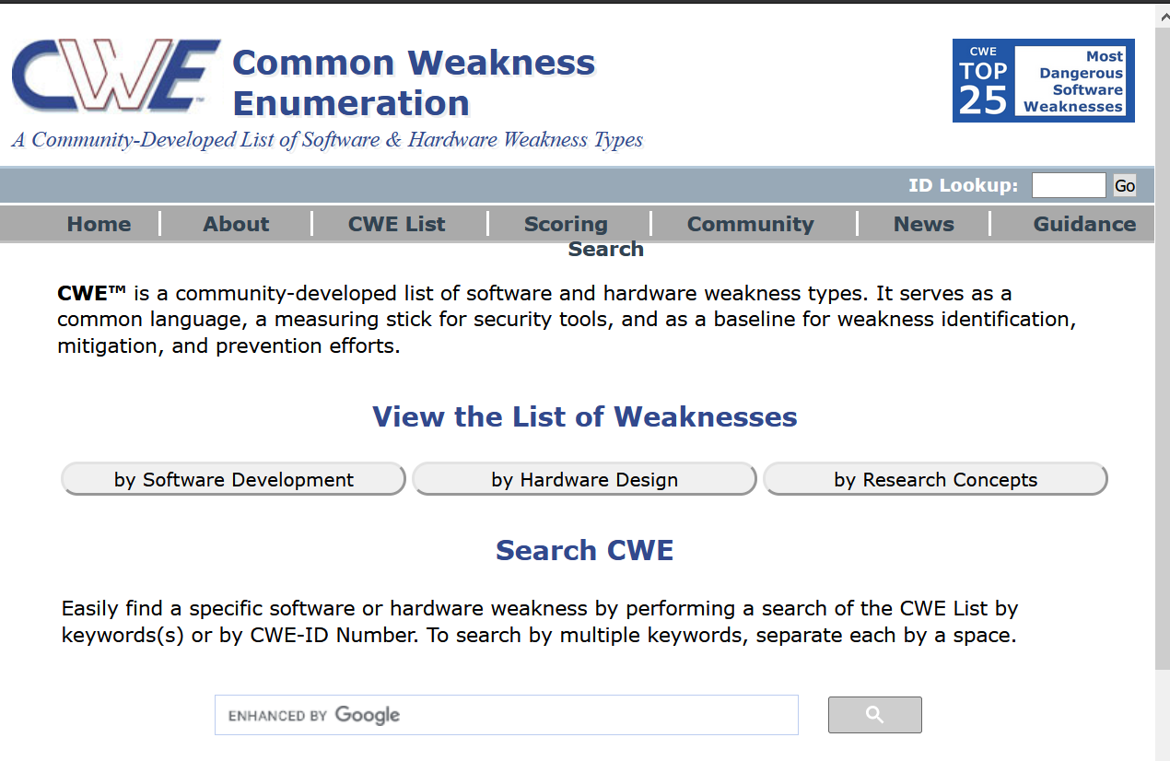
Catalogs of code weaknesses (setting the vocabulary)

Slide 19
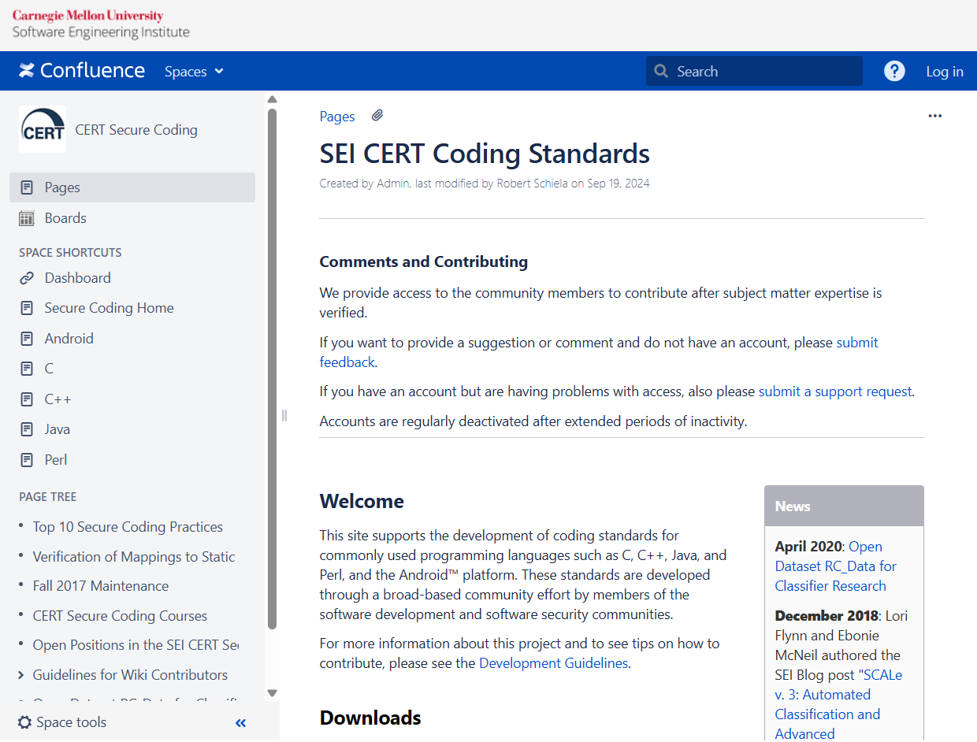
Coding standards for secure code

Slide 20
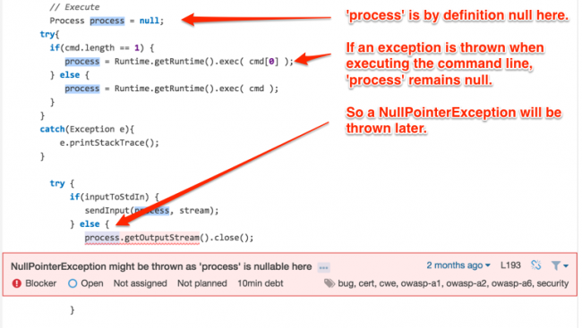
NPE due to a bad exception handling
https://blog.sonarsource.com/sonaranalyzer-for-java-tricky-bugs-are-running-scared/

Slide 21
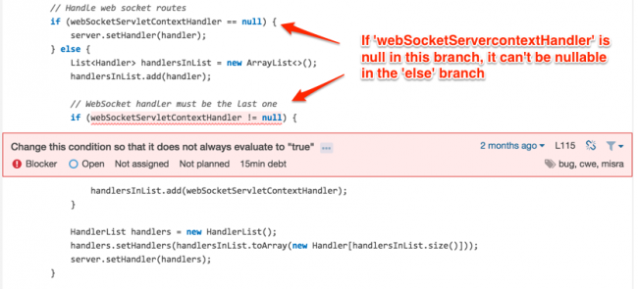
Useless condition
https://blog.sonarsource.com/sonaranalyzer-for-java-tricky-bugs-are-running-scared/

Slide 22
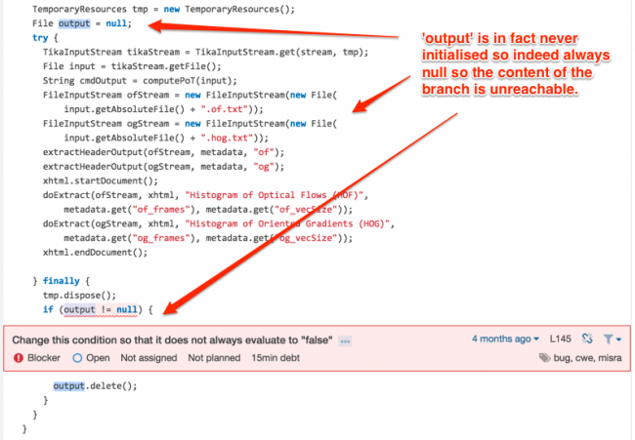
Suspect unreachable branch

Slide 23
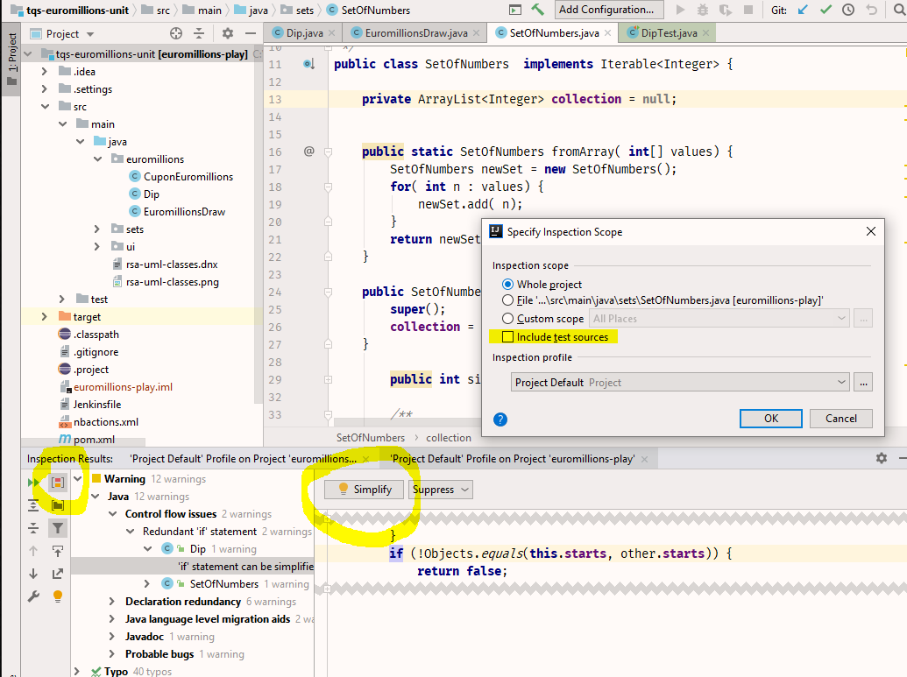
Code inspection in IntelliJ

Slide 24

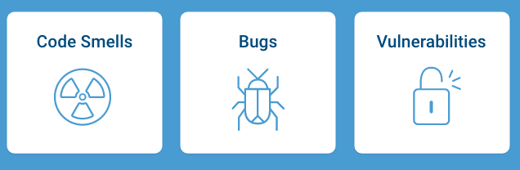
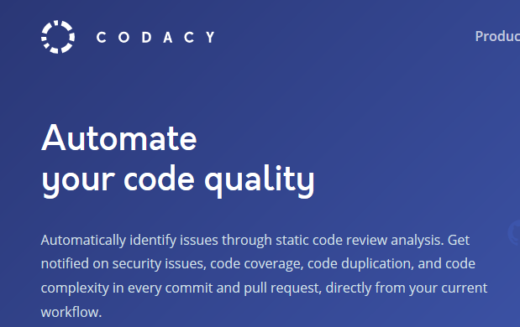
Advanced inspection frameworks

Slide 25
Sonar Qube concepts
Code Smell
  A maintainability-related issue in the code. Leaving it as-is means that at best maintainers will have a harder time than they should making changes to the code. At worst, they'll be so confused by the state of the code that they'll introduce additional errors as they make changes.
Bug
  An issue that represents something wrong in the code. If this has not broken yet, it will, and probably at the worst possible moment. This needs to be fixed.
Vulnerability
  A security-related issue which represents a potential backdoor for attackers.
https://docs.sonarsource.com/sonarqube-cloud/discovering-sonarcloud/what-sonarcloud-can-do

Slide 26
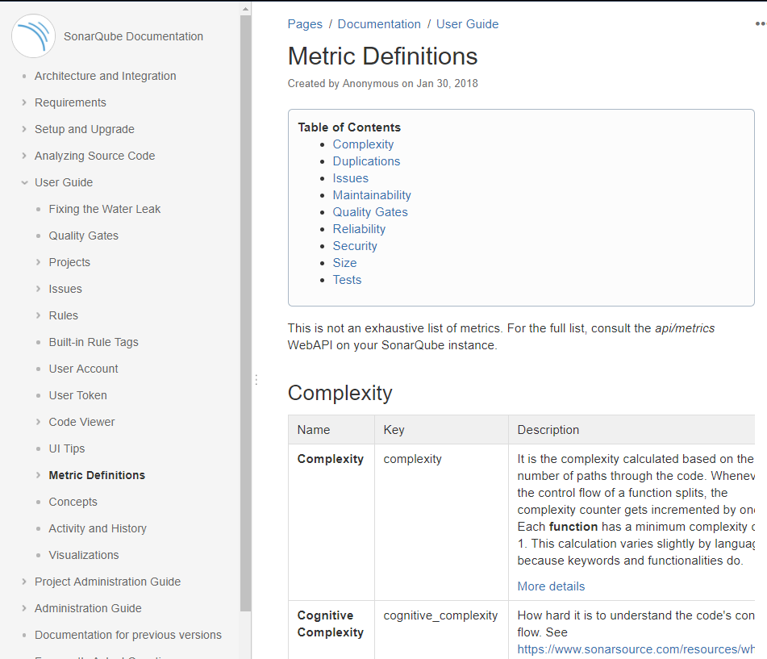
https://docs.sonarqube.org/latest/user-guide/metric-definitions/

Slide 27
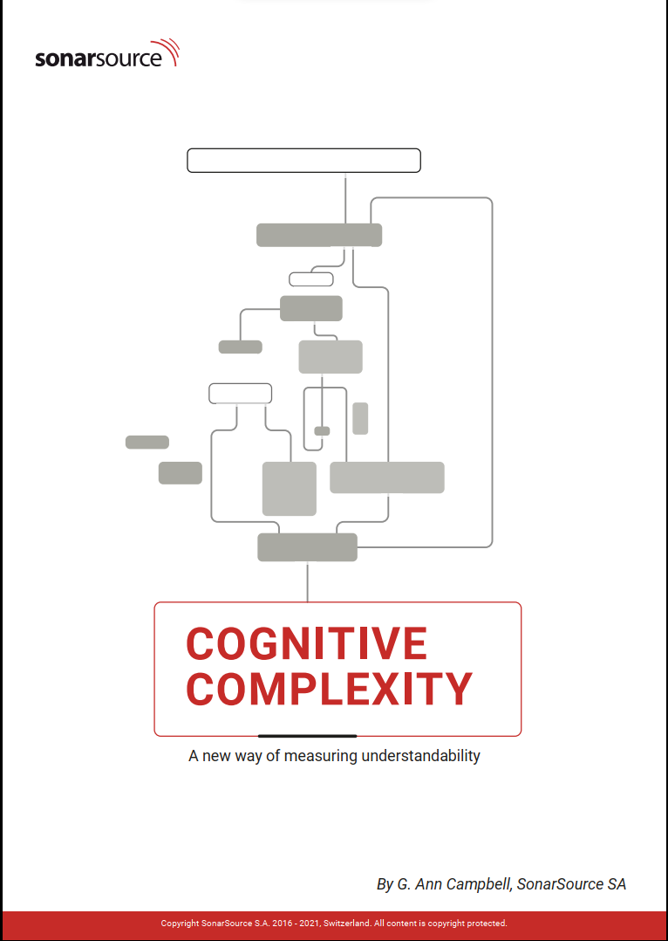
Complexity metric
cyclomatic complexity
  defines the number of independent paths in the basis set of a program and provides you with an upper bound for the number of tests that must be conducted to ensure that all statements have been executed at least once
  See also:
  - Sonar whitepaper

Slide 28
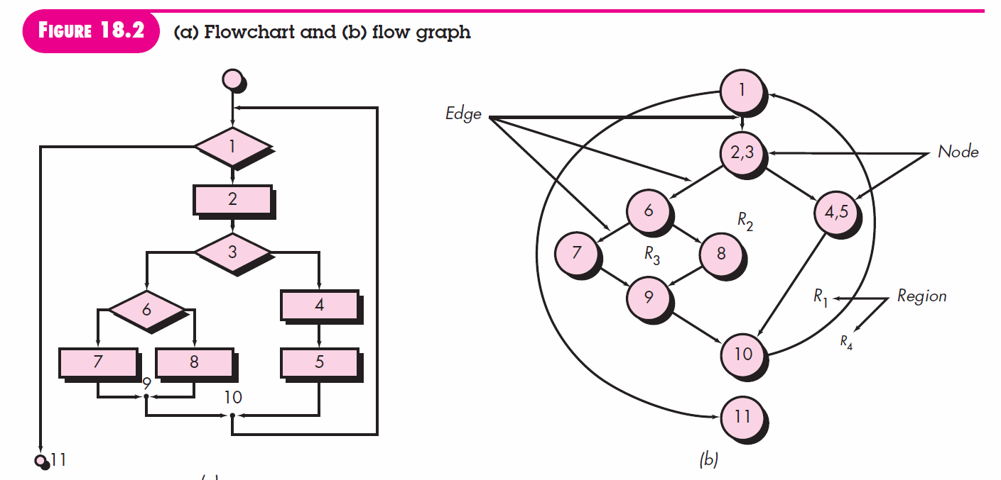
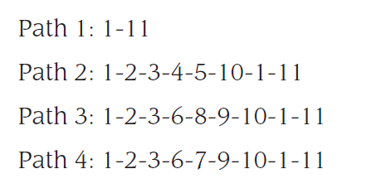
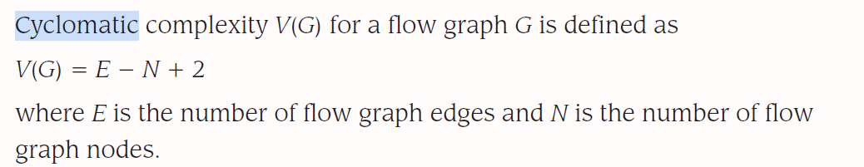


Slide 29
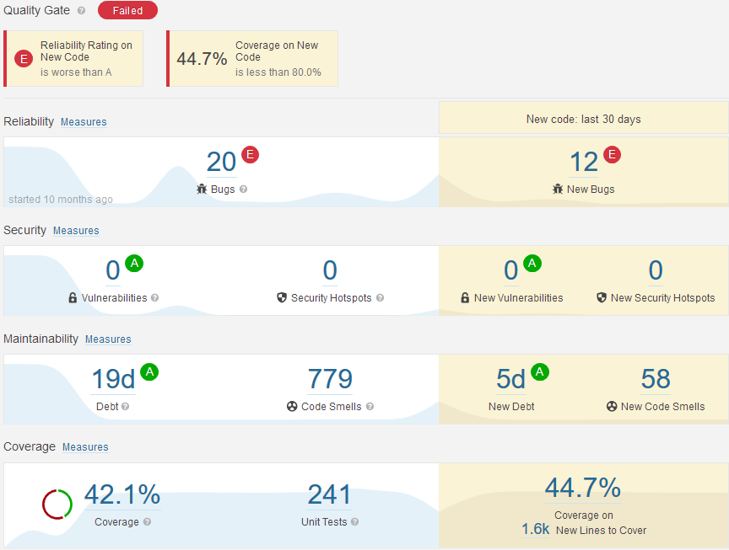
Sonar metrics for a QA dashboard
Code that most likely is an error → not reliable
Constructions that pose security risks.
Constructions contrary to maintainability & best practices
How much code is being used by tests?

Slide 30
Technical debt

Slide 31
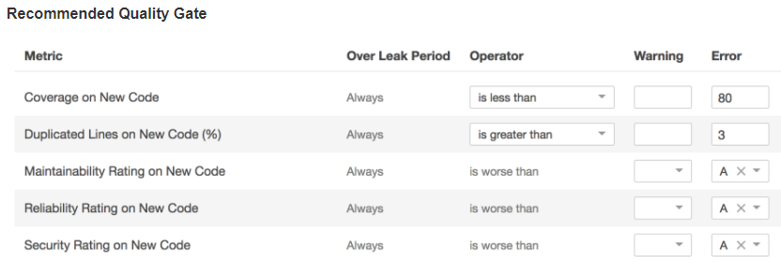

Quality gates
  Ready for delivery? Yes, if the defined Quality Gate is met.

Slide 32
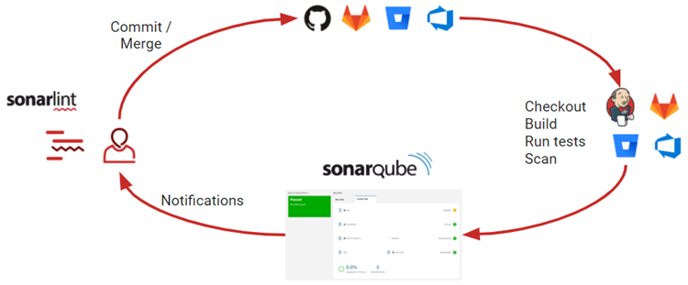
Integrate SonarQube in the development pipeline

Slide 33
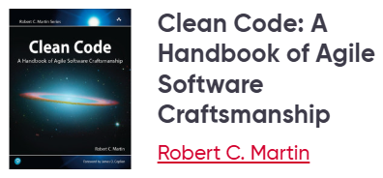
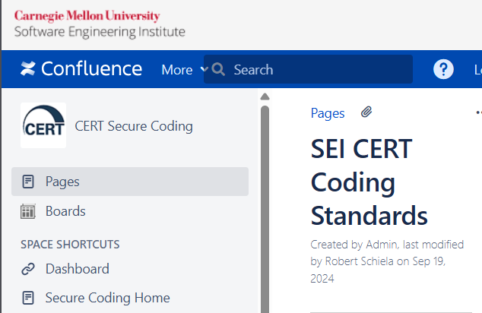
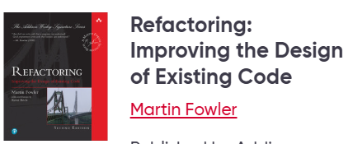
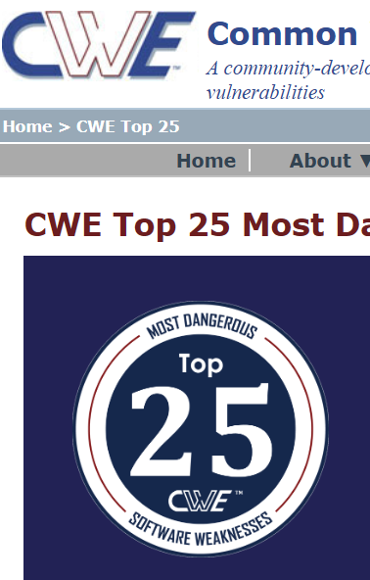
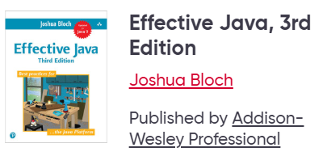

Hands-on

